Slide 1
SNS ACADEMY
A fingerprint International School
Affiliated to CBSE New Delhi
Affiliation No :1930610
GRADE : 9 (2022-23)
COURSE NAME : SOCIAL SCIENCE
Geography Chapter-3
DRAINAGE

Slide 2
DRAINAGE
River system of an area is called drainage .
River system consist of one Main river and several small rivers, that joins main river.
Finally these rivers drains into oceans , seas or lakes.

Slide 3
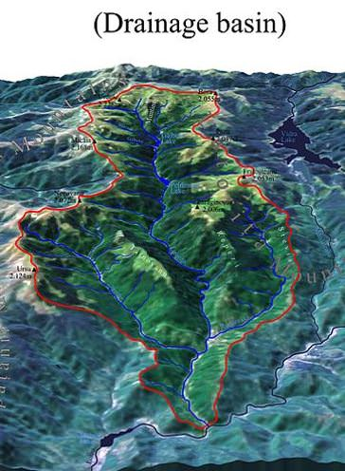
Drainage Basin
The area drained by
a single river system
is called
drainage basin.

Slide 4
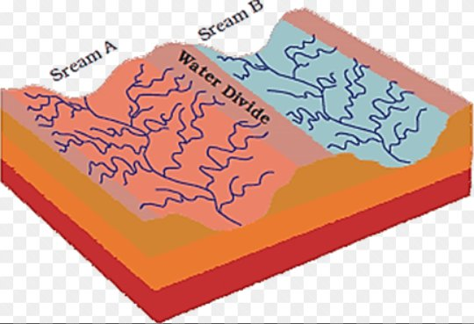
WATER DIVIDE
Elevated area such as a mountain or an upland separates two drainage basins. Such an upland is known as a water divide.

Slide 5
DRAINAGE SYSTEM IN INDIA
Indian rivers are divided into two major groups.
Himalayan rivers
and
Peninsular rivers
The Himalayan and Peninsular rivers are different from each other in many ways.

Slide 6
Most of the Himalayan rivers are perennial.
Sources of this rivers are glaciers and rainwater.
The Himalayan rivers have long gorges.
(gorges means a narrow valley with steep sides and river running through it).

Slide 7
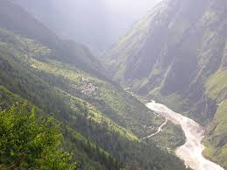
Gorges

Slide 8
This rivers have long courses from their source to the sea.
They perform intensive erosional activities in their upper courses.
it carries huge loads of silt and sand.

Slide 9
In the middle and lower courses,these rivers form meanders, oxbow lakes,and many other depositional features in their floodplains.
They also have well developed deltas

Slide 10
OXBOW LAKES
An oxbow lake is a U-shaped lake or pool that forms when a wide meander of a river is cut off,

Slide 11
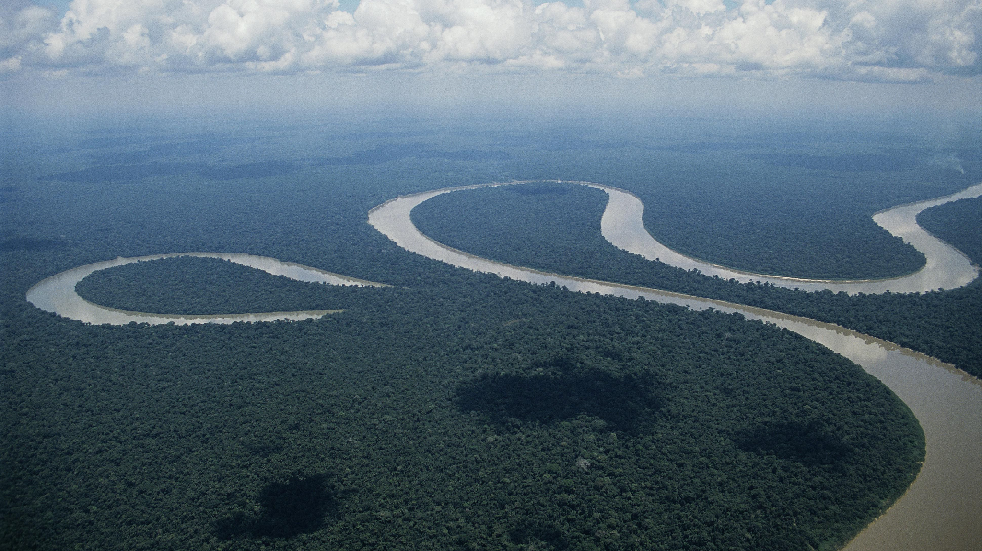
OXBOW LAKH

Slide 12
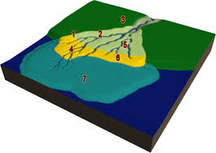
DELTA

Slide 13
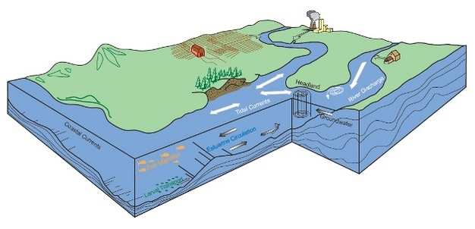
ESTUARY

Slide 14
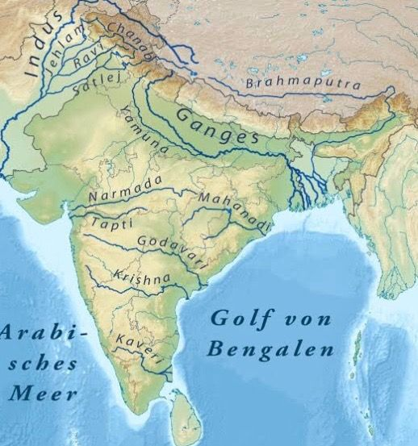

Slide 15
What is drainage?
Drainage basin?
Water divides.
What are the major groups of Indian rivers?
Oxbow lakes
Estuary
https://docs.google.com/document/d/13noIYFj2KFrJzpS__4HD_Q9S3cb0gpbn990Z_4UrLBI/edit?usp=sharing

